Slide 1
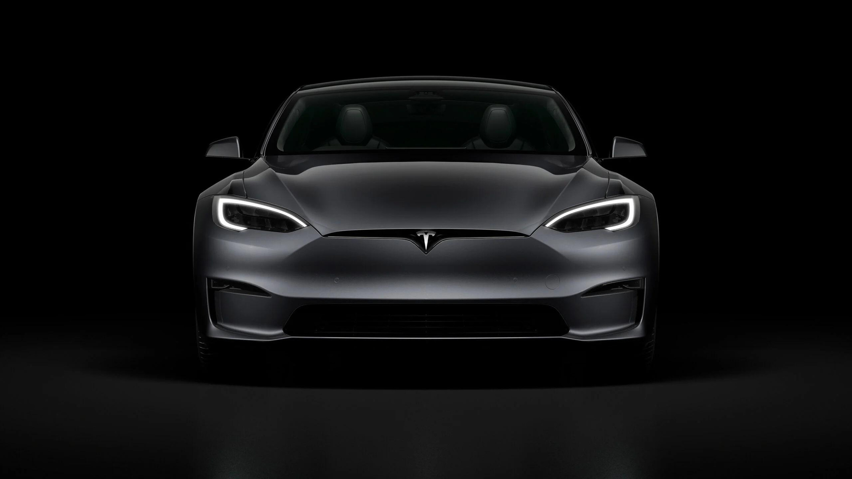



Team members:
Zeyad Osama
Radwa Alaa

Slide 2
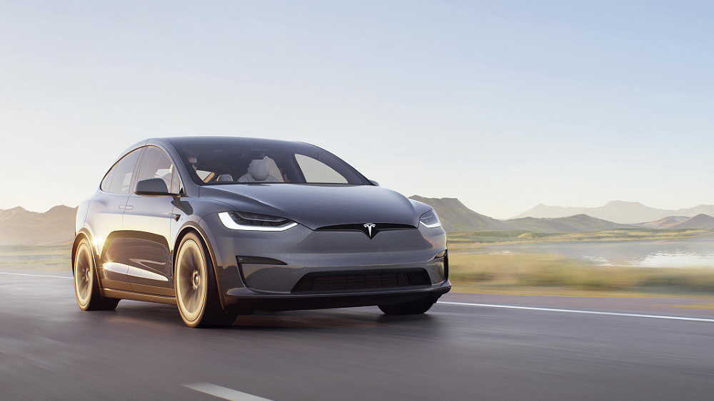
Set Objectives
Data Collection
Data Preparation
Data Visualization
OUTLINE

Slide 3



TESLA REVENUES
SETTING
OBJECTIVES
TESLA STOCK PRICES
BEST SELLING MODELS

Slide 4
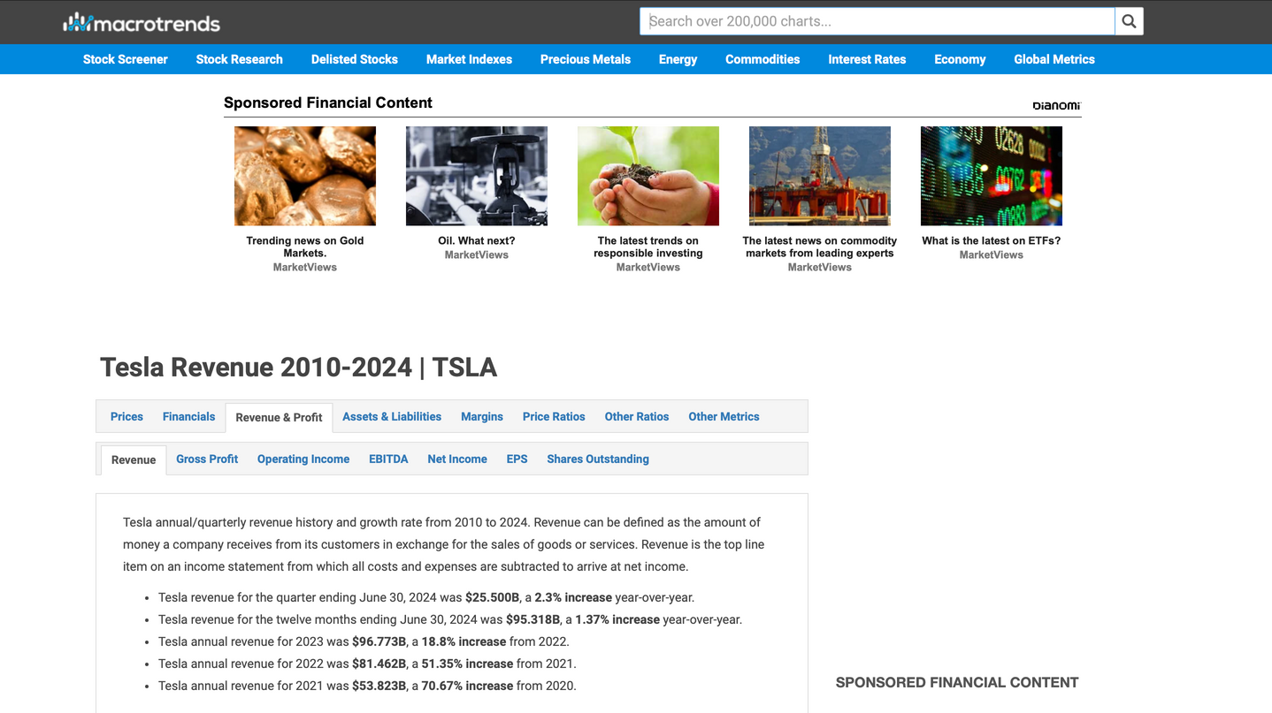
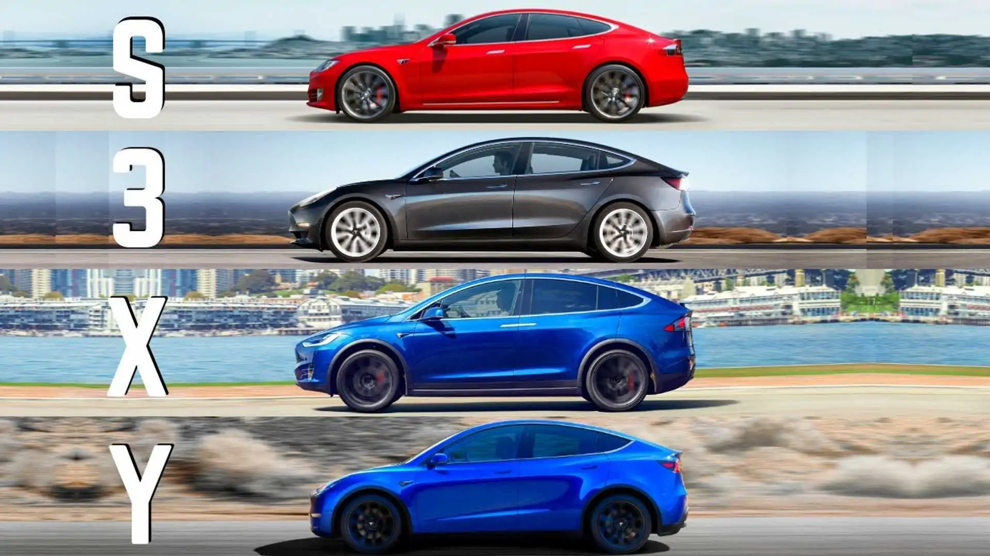


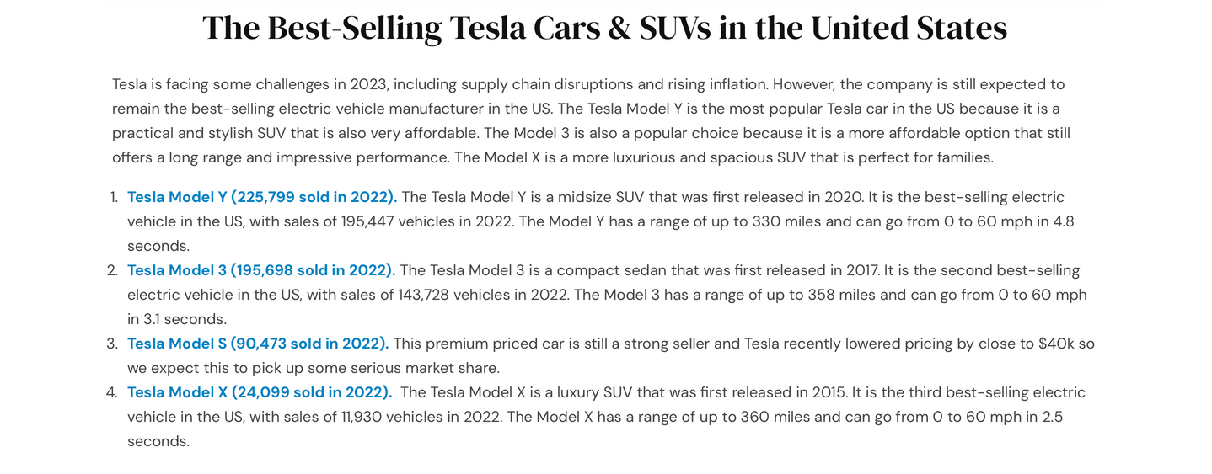
DATA
COLLECTION
TESLA REVENUES
TESLA STOCK PRICES
BEST SELLING MODELS

Slide 5
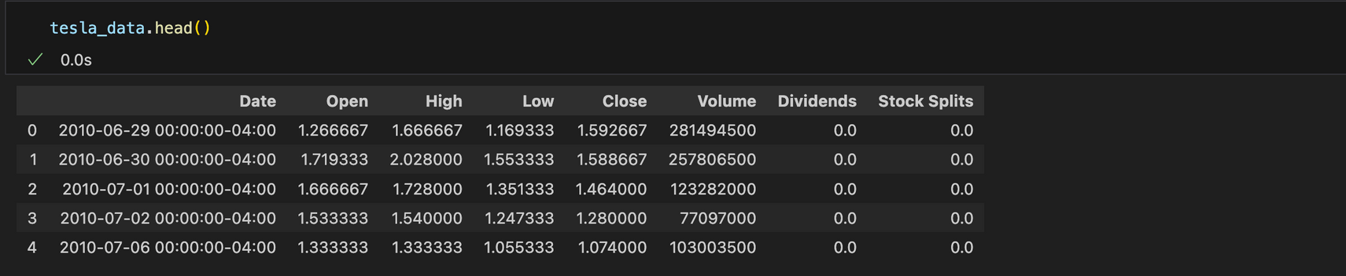
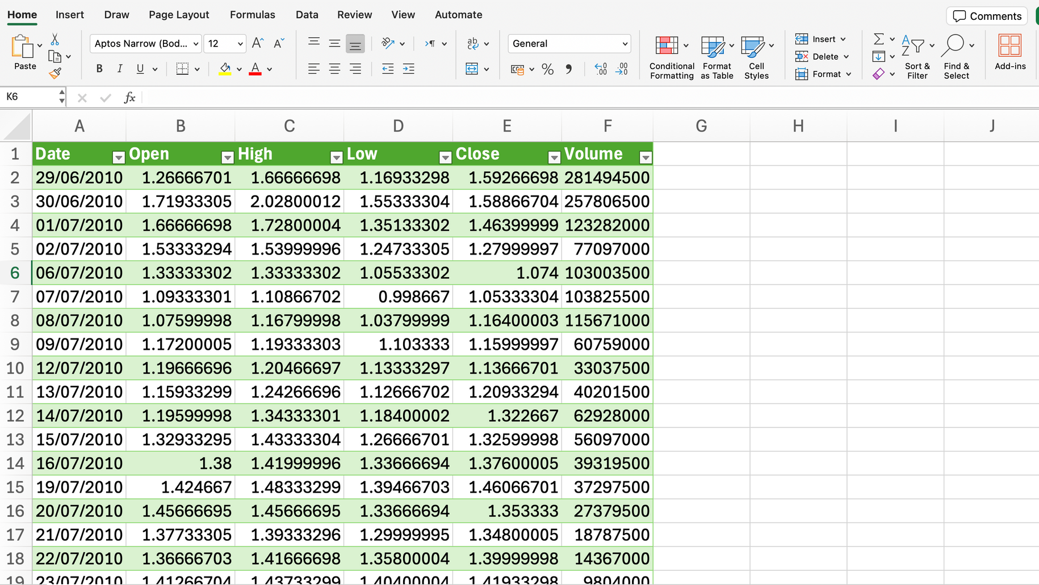
DATA
PREPARARTION

Slide 6


DATA
PREPARARTION

Slide 7




DATA
VISUALIZATION
POWER BI
MICROSOFT EXCEL
TABLEAU

Slide 8
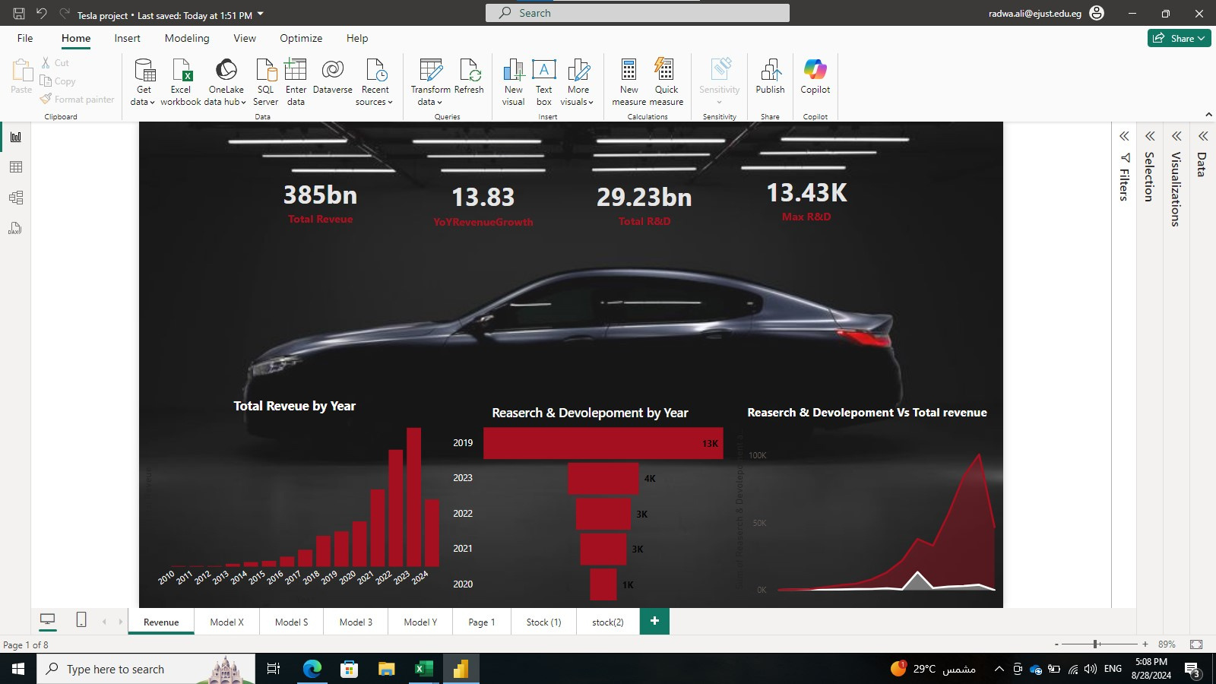
DATA
VISUALIZATION

Slide 9
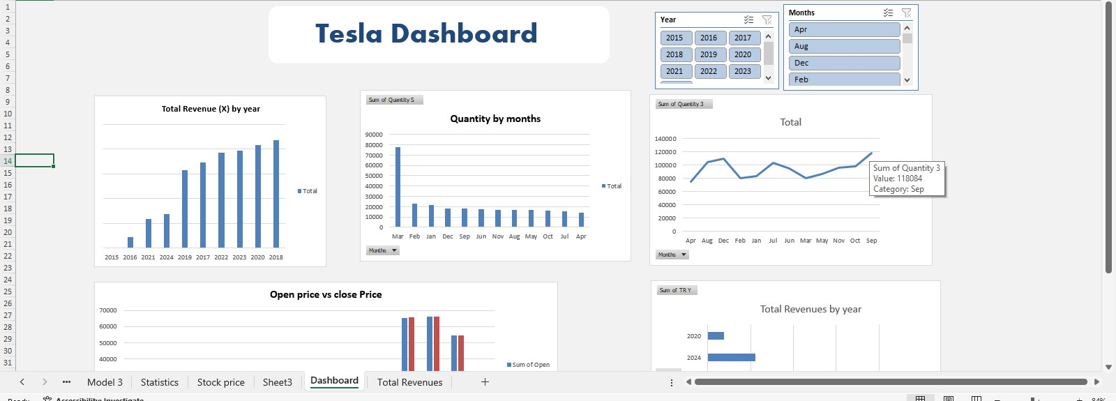
DATA
VISUALIZATION

Slide 10
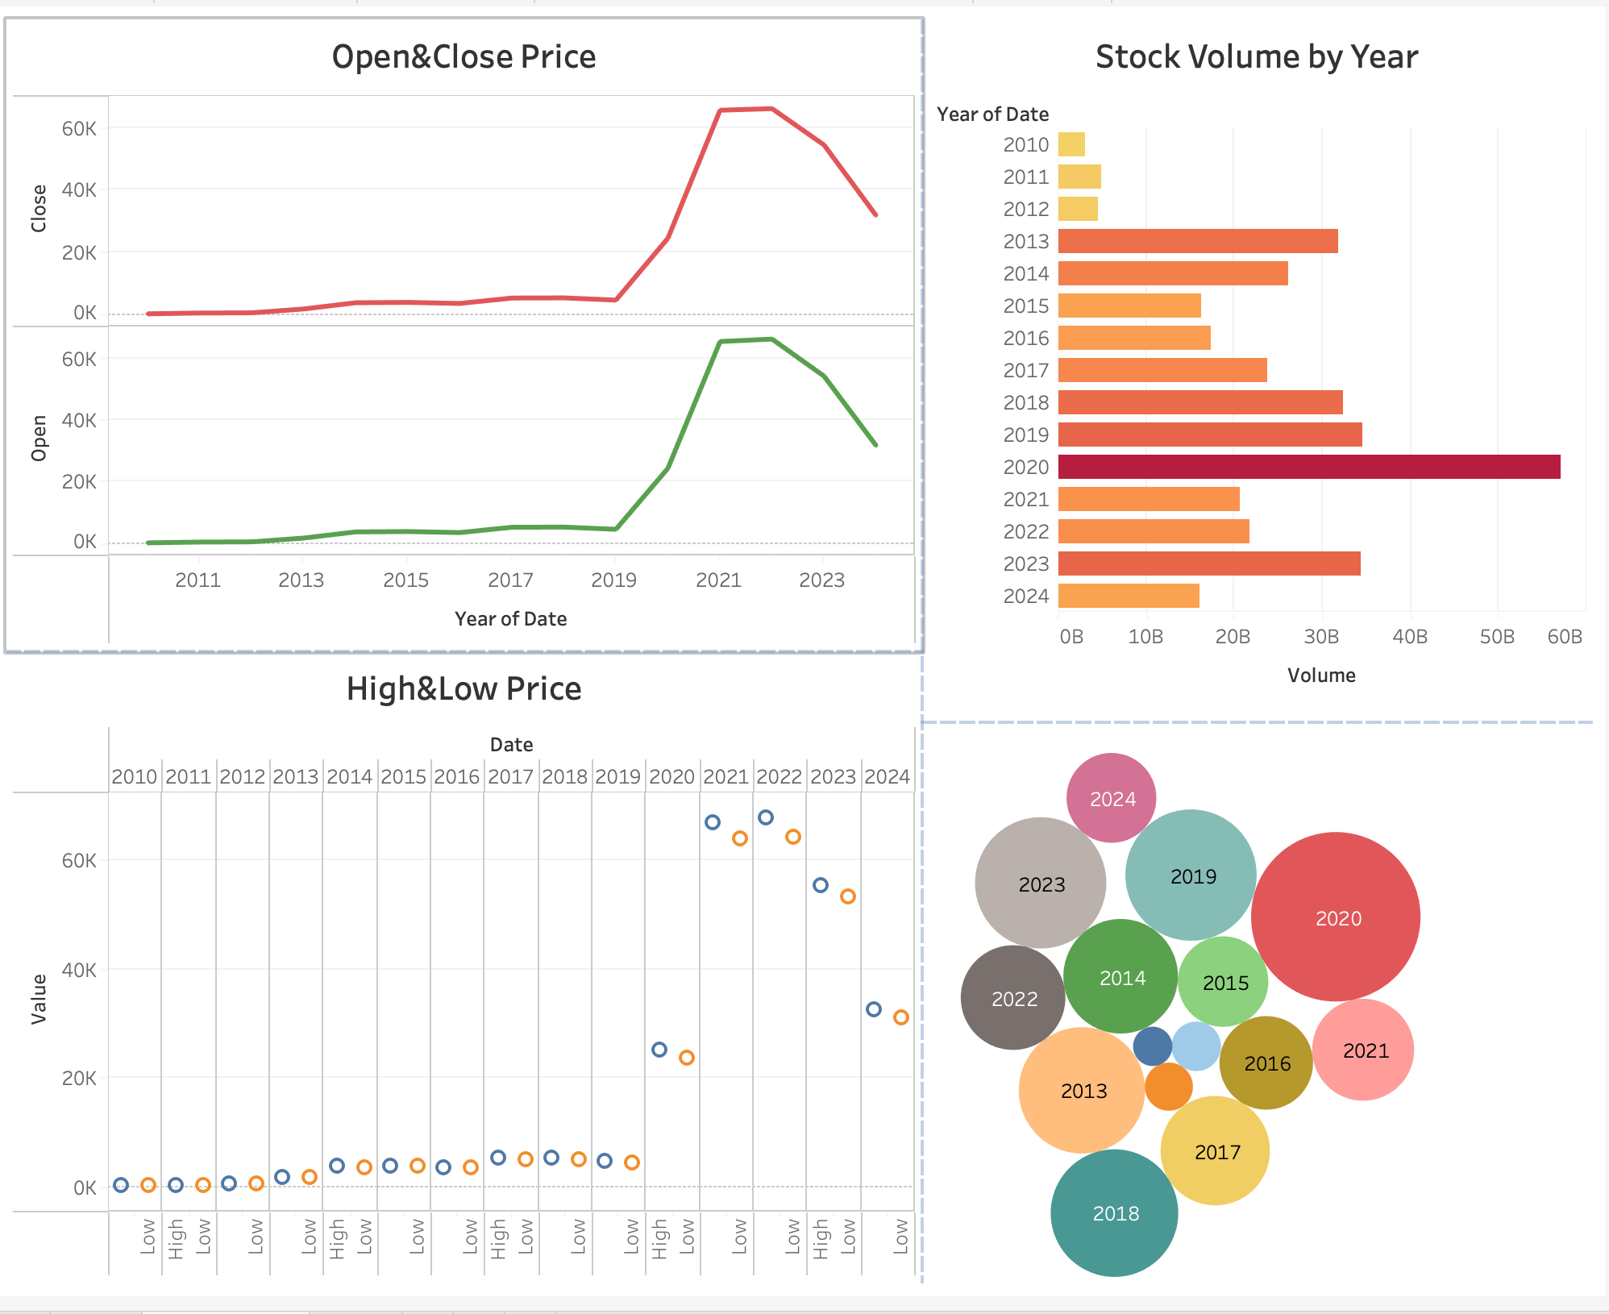
DATA
VISUALIZATION

Slide 11
THANK YOU

